Slide 1




a jump-start for .NET developers
presented by Bryan Hunter Firefly Logic
Twitter #ndcoslo #erlang @bryan_hunter
@fireflylogic

Slide 2
?

Slide 3
Ett språk er aldri nok
(one language is never enough)

Slide 4
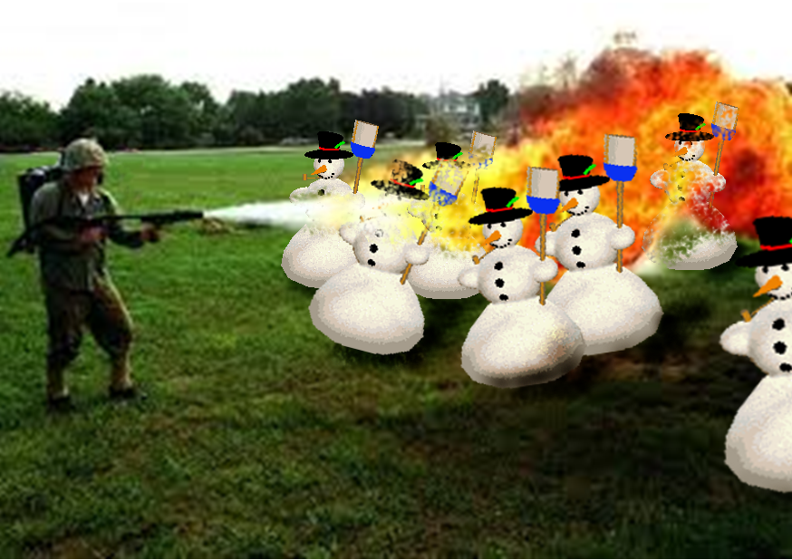
Right tool for the job!

Slide 5
What’s Erlang?
Erlang (the language)
+
OTP
+
The ERTS
(Erlang Runtime System)

Slide 6
Erlang (the Language)
Functional
immutability, higher-order functions, referential transparency, separation of behavior and data, recursion,
Declarative, Dynamic, Compiled
Concurrency- oriented
Different model of the world
Prolog roots
Pattern matching

Slide 7
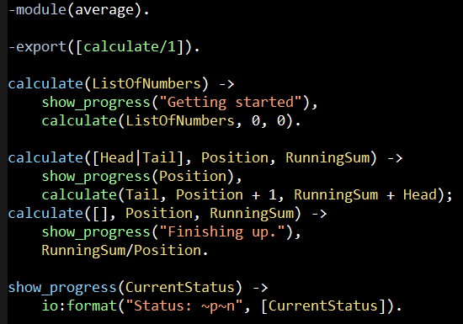
Erlang (the Language)
File: average.erl

Slide 8
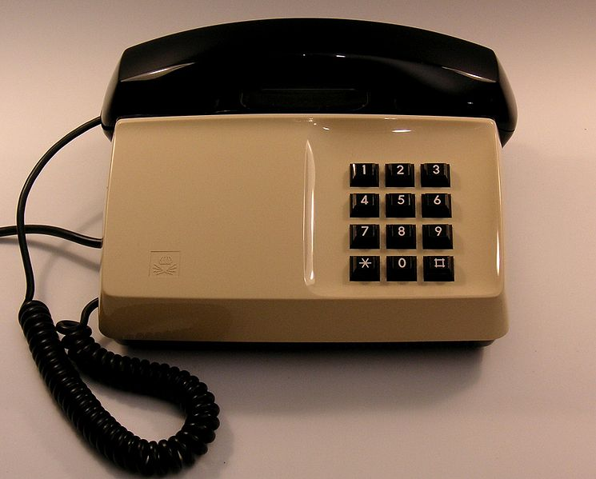
OTP

Slide 9
Erlang Runtime System (in-context)
.NET dev stack
Erlang dev stack
C# / F#
Erlang / Elixir / Joxa
.NET Framework
OTP
CLR
ERTS
VM + Kernel
+ STDLIB
OS (Windows)
OS (Windows, Linux, Mac, None)

Slide 10
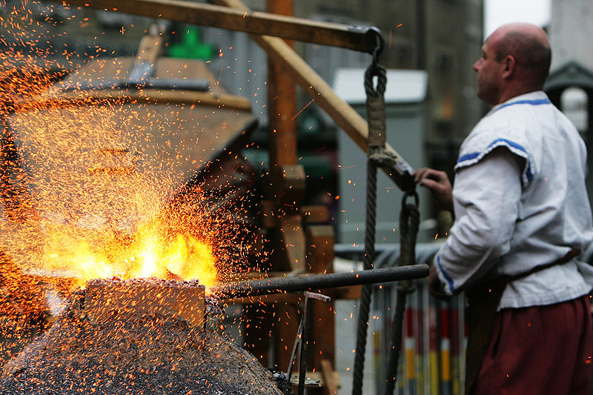
OTP
Erlang Runtime System

Slide 11
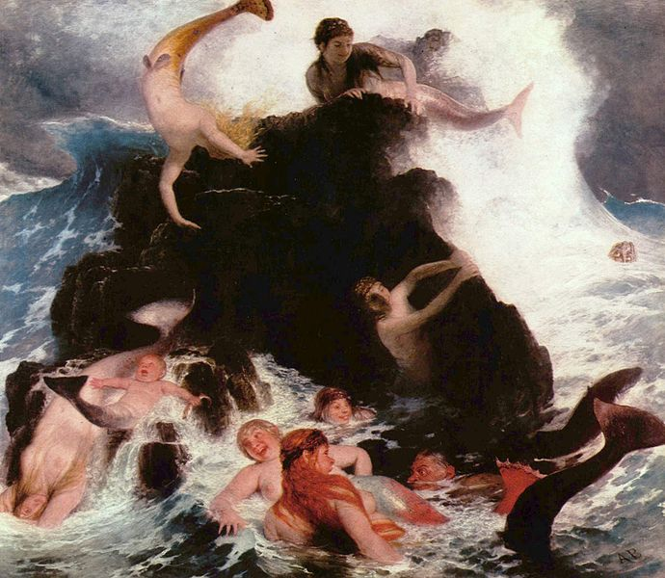

Any sufficiently complicated concurrent program in another language contains an ad hoc informally-specified bug-ridden slow implementation of half of Erlang.

Slide 12
Erlang in less than 140 characters
Erlang is open, proven and cross-platform. It simplifies writing reliable, concurrent, distributed systems. Its pattern matching is FTW.

Slide 13
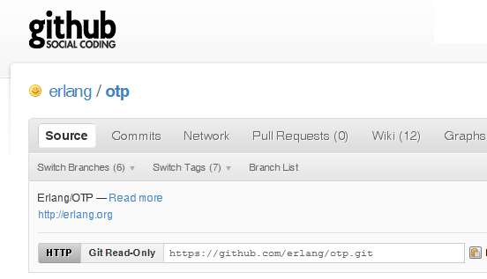

Why -> Erlang is open

Slide 14
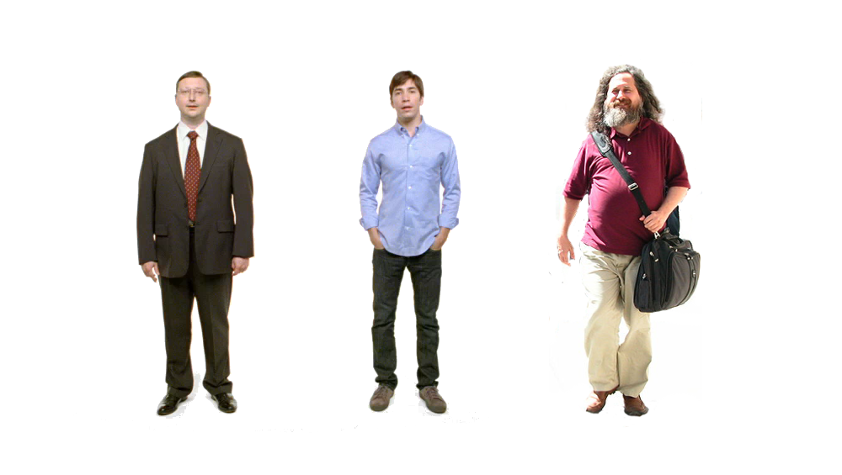
Erlang
Erlang
Erlang
Why -> Erlang is cross-platform

Slide 15



















Why -> Erlang is proven

Slide 16
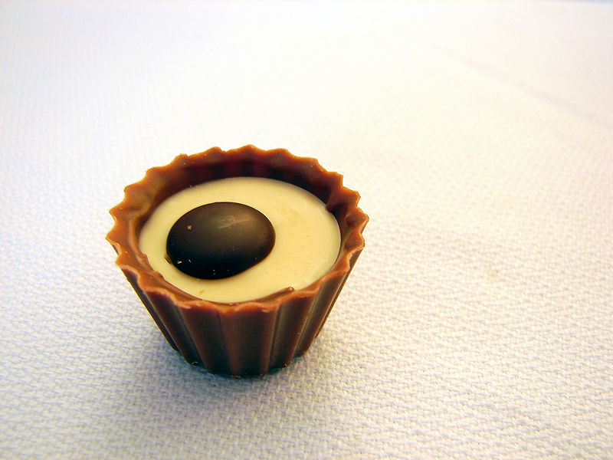
What are the sweet spots?

Slide 17
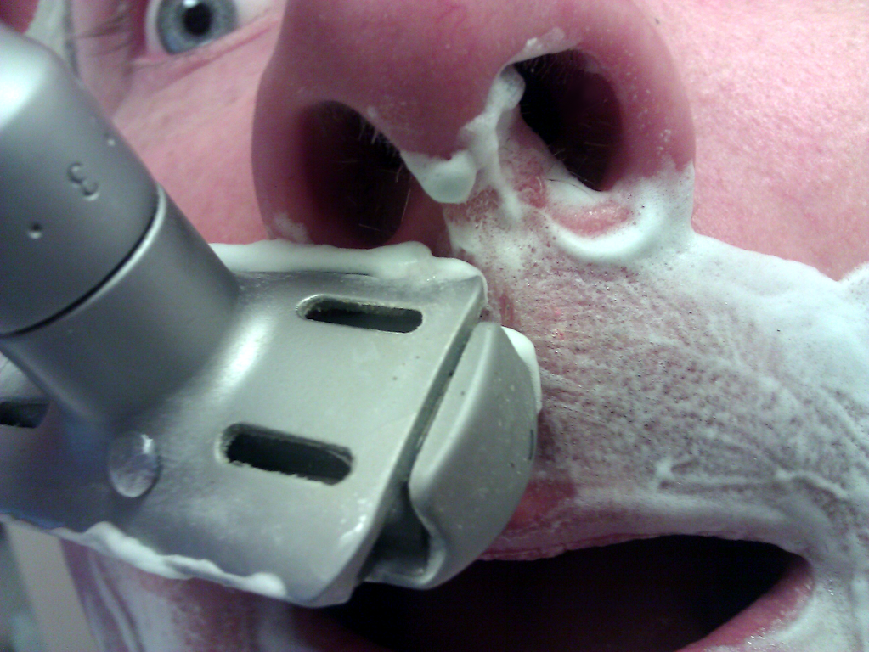
Why -> elsewhere concurrency is painful

Slide 18
Two thing to remember about
Concurrency
1) Shared memory concurrency is hard
2) Message passing concurrency is easy

Slide 19
Erlang Processes
are the unit of concurrency.
You structure your programs around these units of concurrency.

Slide 20
“The performance
of a concurrent language
is predicated by three things:
the context switching time,
The message passing time,
and the time to create a process.”
–Mike Williams

Slide 21
One .NET 4.0 Thread (allocates one megabyte)
**********
**********
**********
**********
**********
**********
**********
**********
**********
**********
**********
**********
**********
**********
**********
**********
**********
**********
**********
**********
**********
**********
**********
**********
**********
**********
**********
**********
**********
**********
**********
**********
**********
**********
**********
**********
**********
**********
**********
**********
**********
**********
**********
**********
**********
**********
**********
**********
**********
**********
Heap
Mailbox
Stack
**********
**********
**********
**********
**********
**********
**********
**********
**********
**********
**********
**********
**********
**********
**********
**********
**********
**********
**********
**********
**********
**********
**********
**********
**********
**********
**********
**********
**********
**********
**********
**********
**********
**********
**********
**********
**********
**********
**********
**********
**********
**********
**********
**********
**********
**********
**********
**********
**********
**********
Garbage Collector
Links and Monitors
One Erlang Process (allocates one kilobyte)
*
Why -> elsewhere concurrency is painful

Slide 22
*
*
*
Reductions
- Do 2,000 operations
reduction1 reduction3 .
Reduction2000
- Move to the next guy - Repeat
CPU Core
Why -> near zero context switching cost

Slide 23
worker
supervisor
*
*
CPU Core
Why -> supervision

Slide 24
***** *****
***** *****
***** *****
***** *****
Core
Core
Core
Core
Why -> elsewhere concurrency is painful

Slide 25

Distribution: built-in from the start

Slide 26

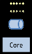
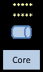
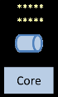
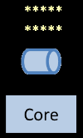
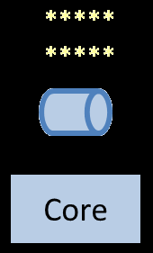
Distribution: built-in from the start

Slide 27
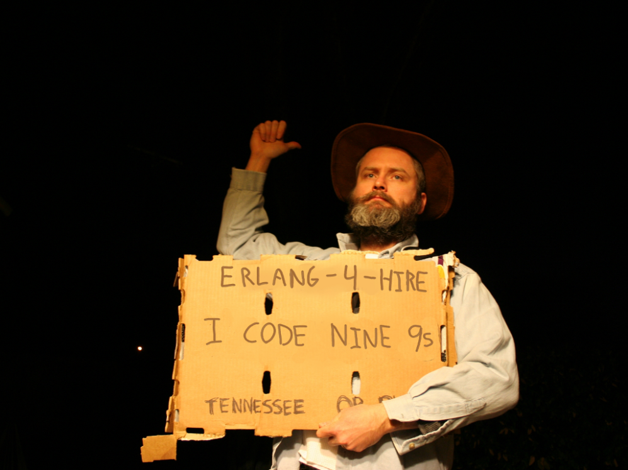
Nines | Uptime | Annual Downtime
9 | 99.9999999% | 30 milliseconds
8 | 99.9999990% | 300 milliseconds
7 | 99.9999900% | 3 seconds
6 | 99.9999000% | 32 seconds
5 | 99.9990000% | 5 minutes
4 | 99.9900000% | 53 minutes
3 | 99.9000000% | 8 hours, 46 minutes
2 | 99.0000000% | 3 days, 15 hours, 36 minutes
Safe
Supervisor
Worker
Worker
Links and monitors
No masters
Hot code loading
simple distribution, safe concurrency
Why -> reliability

Slide 28
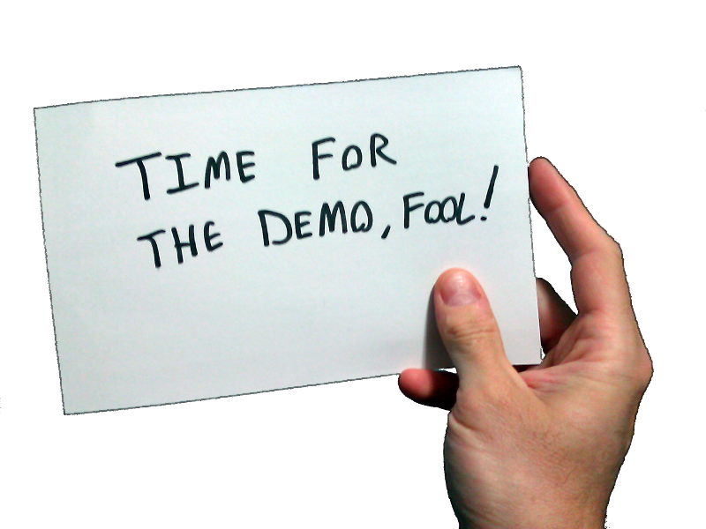
Erlang!
What exactly is Erlang?
Why Erlang?
How do you do it?
In the shell
In a text editor + command line + shell
In Emacs

Slide 29
[insert awe-inspiring demos here]

Slide 30
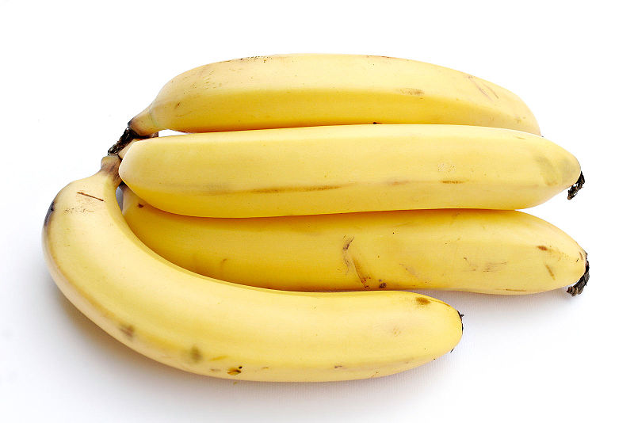

Slide 31
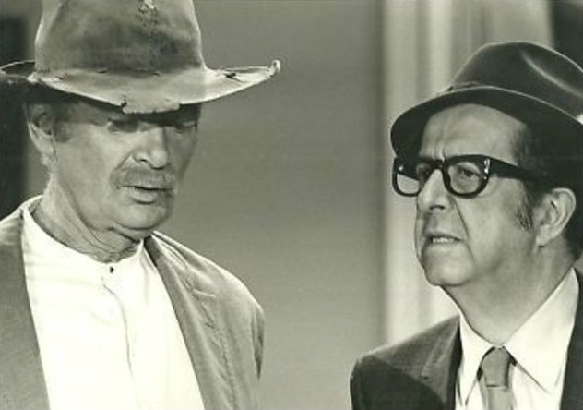
How do you begin to lose your C# accent?
View immutability as your friend
Stop hording state
Begin to use higher-order functions
Replace conditional logic with pattern matching
Begin to think recursively and replace loops with recursion
Start teasing out behavior from data

Slide 32
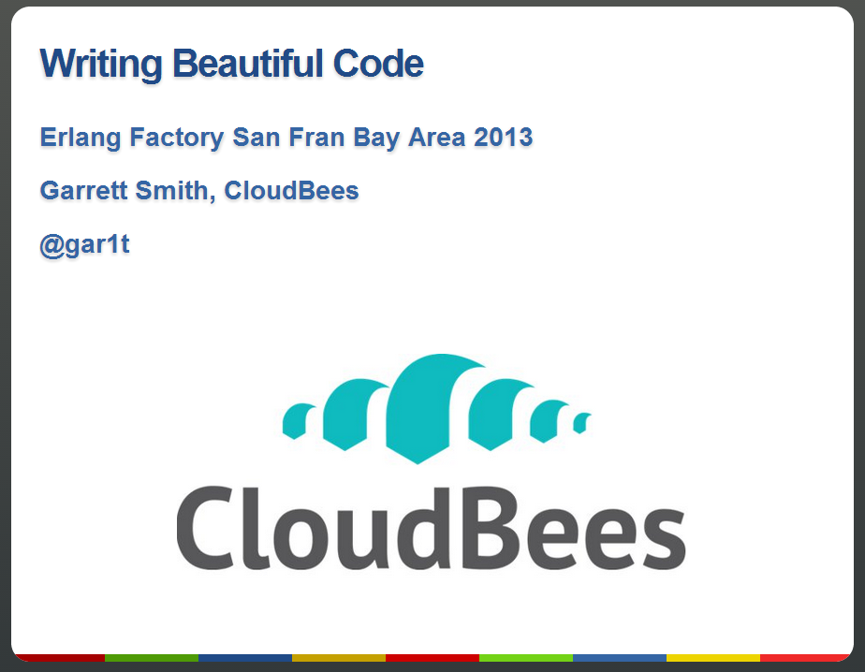
How do you begin to lose your C# accent?

Slide 33
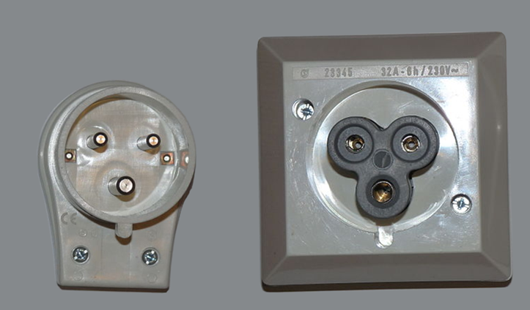
What are the best interop strategies?
Pssst, pssps…spsss.
You want to put what? where!?

Slide 34
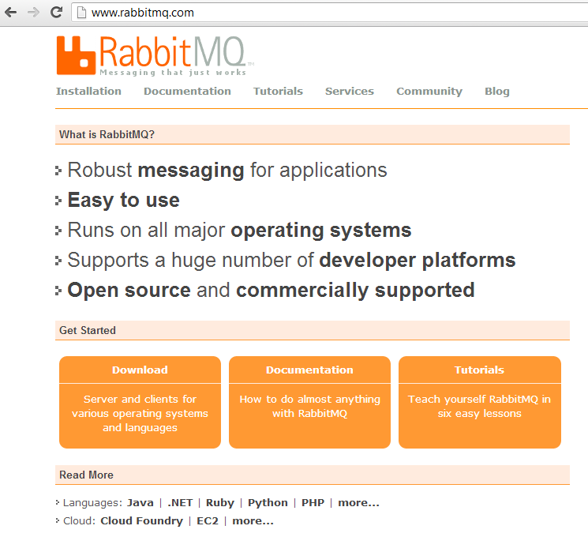
What are the best interop strategies?
Web Server (Cowboy, Webmachine, Yaws, …)
Sockets
JSON, Protobuf, …
OTP.NET

Slide 35
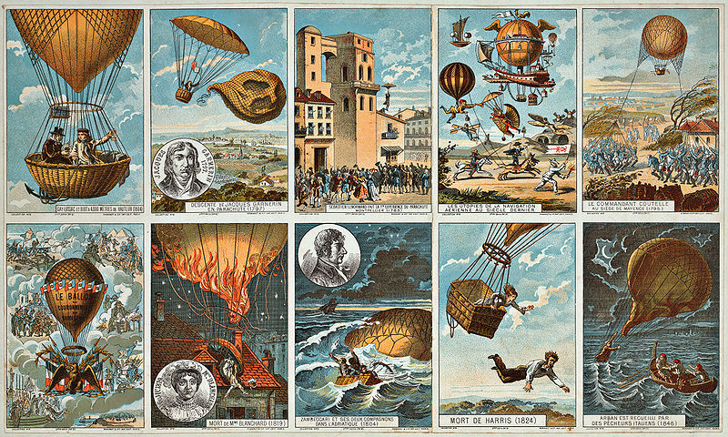
How to pilot Erlang?

Slide 36
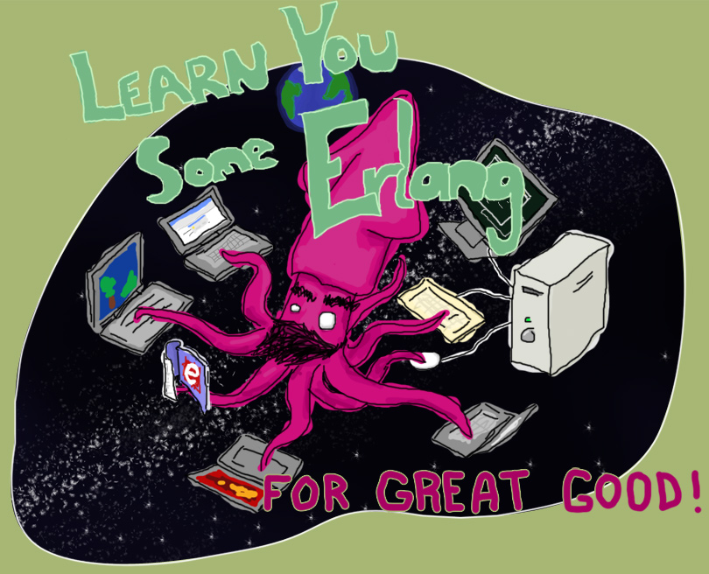
“Learn You Some Erlang for Great Good!” http://learnyousomeerlang.com/
How -> read this excellent and free online book

Slide 37



Start here
How -> read some books

Slide 38
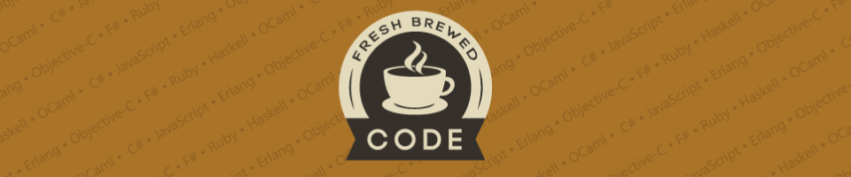
My blog:
http://freshbrewedcode.com/bryanhunter/
How -> visit my blog

Slide 39
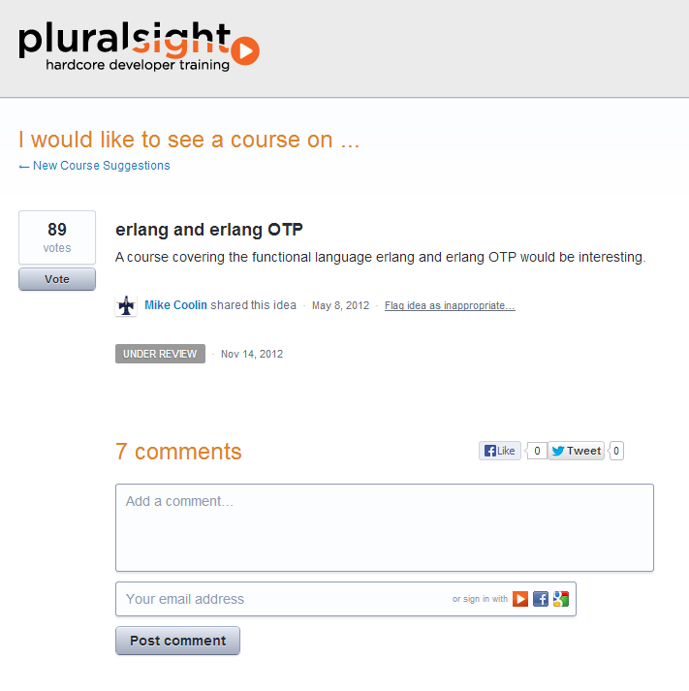
How -> Nag Pluralsight

Slide 40

http://erlangcamp.com
How -> Two day intense hands-on training

Slide 41

http://nashfp.org
How -> Better yet; pack up and move to Nashville!

Slide 42
Questions?
Bryan Hunter
Twitter: @bryan_hunter
Email: bryan.hunter@fireflylogic.com
Firefly Logic, Inc.
1000 Main Street, Suite 201 Nashville, TN 37206
http://fireflylogic.com
How -> keep in touch

